Slide 1
Vision Awareness Resources
Copyright and Usage Notice
This training resource is intended for use by transport operators and frontline staff, specifically bus drivers, to improve support for blind and partially sighted passengers. Please review the terms below before using or distributing this material.
© Thomas Pocklington Trust 2004. All rights reserved
The copyright and other intellectual property rights for bus driver training resources (PowerPoint presentation, facilitator notes and 3 embedded films) are owned by Thomas Pocklington Trust (TPT) and should not be adapted or amended without prior consultation and agreement with TPT. By downloading and using this resource pack you are agreeing to these terms. For further information email TPT at: info@pocklington.org.uk

Slide 2

Introduction
Thomas Pocklington Trust (TPT) has created these resources to help you feel confident supporting blind and partially sighted passengers.
With support from Guide Dogs, we are bringing this training to more drivers across the UK bus network, so you have the tools to provide safe, inclusive journeys.
Sight Loss Councils, led by blind and partially sighted people with lived experience of sight loss, have produced this presentation.
Sight Loss Councils are funded by Thomas Pocklington
Trust.

Slide 3
Accessible Bus Travel for
Blind and Partially Sighted People
“I have to forward plan my journey, sometimes the apps don’t work, or the website to check a timetable isn't accessible. I wait at the bus stop hoping that the bus is going to stop for me. I worry that the driver won’t announce a stop when I’ve arrived at my destination, and I clock watch all day with the same anxieties for my journey home.”
(Iris, East Sussex Sight Loss Council Volunteer)

Slide 4
Aims and Objectives
By the end of this session you will:
Understand the challenges of bus travel for blind and partially sighted people
Know how to recognise someone who is blind or partially sighted
Be better equipped to support blind and partially sighted passengers
Learn about different sight conditions
Have a better understanding of how to guide a blind or partially sighted person.

Slide 5


Statistics
How many people live with vision impairment in the UK?
1 million
2 million
3 million
4 million
= b)
In 2024, it was suggested that just over 2 million people live with a vision impairment (a sight condition not correctable with glasses, contact lenses or surgery).

Slide 6
Statistics continued
In the UK, what % of blind and partially sighted people said they would like to go out more than they do?
25%
48%
56%
18%
According to RNIB’s All Aboard Report, 56% of blind and partially sighted people said they’d like to go out more than they do.
Source: RNIB All Aboard

Slide 7
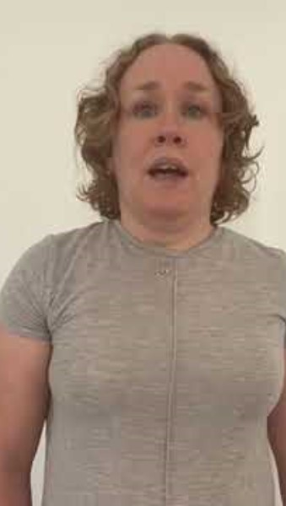
Buses are a Lifeline
Linn,
East Sussex Sight Loss Council Volunteer

Slide 8

Eye Health
How many people are estimated to have a vision impairment in 2050?
3 million
4 million
5 million
6 million
= b)
According to RNIB, it is predicted that 4 million people will be living with a vision impairment by 2050. This is due to people living longer and sight loss being more prevalent in older people.
Early diagnosis is essential to prevent avoidable sight loss. Visiting an optician for regular eye tests is vital for your eye health.

Slide 9
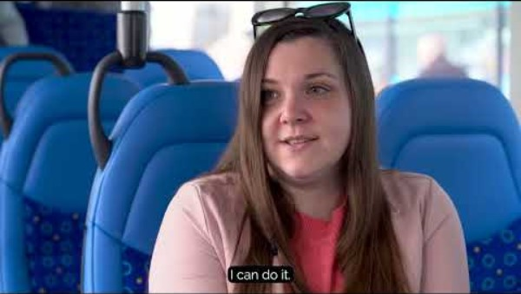
An Accessible Bus Journey
Accessible bus travel is really important to blind and partially sighted people. It’s not just the bus that needs to be accessible, the bus driver plays a huge part too. The following video shows people with lived experience talking about why it’s important to them.

Slide 10
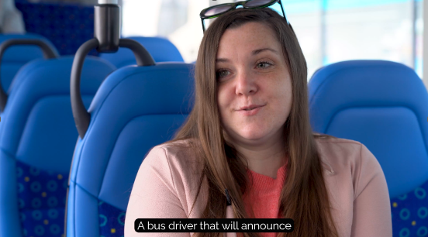
When AV isn’t available…
Your voice matters
By 1st October 2026, the majority of buses will be talking buses.
If your bus has audio-visual (AV) announcements, please check they are switched on.
Where AV isn’t fitted, or isn’t working, please let your passenger know.
Ask which stop they need and announce it as clearly as you approach.
As Sam said in the previous film, “The driver who announces my stop is the best.”
This small step can make all the difference to a blind or partially sighted passenger’s journey.
*Don’t forget to inform the depot if AV is not working.

Slide 11
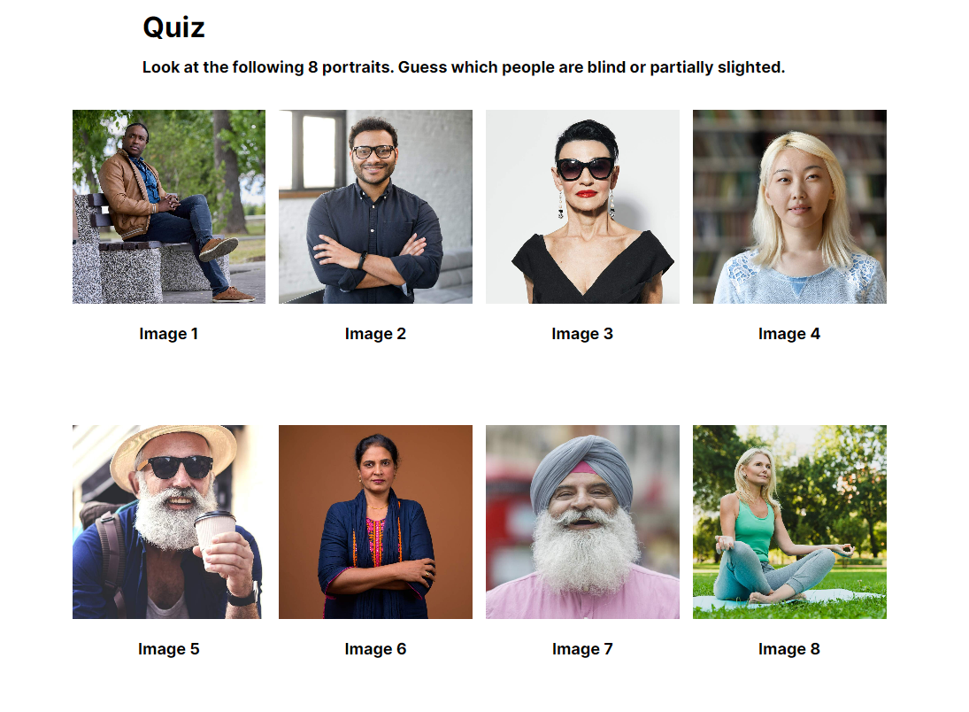
Recognising Blind and Partially Sighted People
There are 8 images of people on the screen, how many of them do think have a vision impairment?
You cannot always recognise a person who is blind or partially sighted, not everybody chooses to use a mobility aid or other support.
Notes:
Choose the ones you think below. Option for multiple answers.
Image 1
Image 2
Image 3
Image 4
Image 5
Image 6
Image 7
Image 8
None of them
All of them
Cannot tell

Slide 12
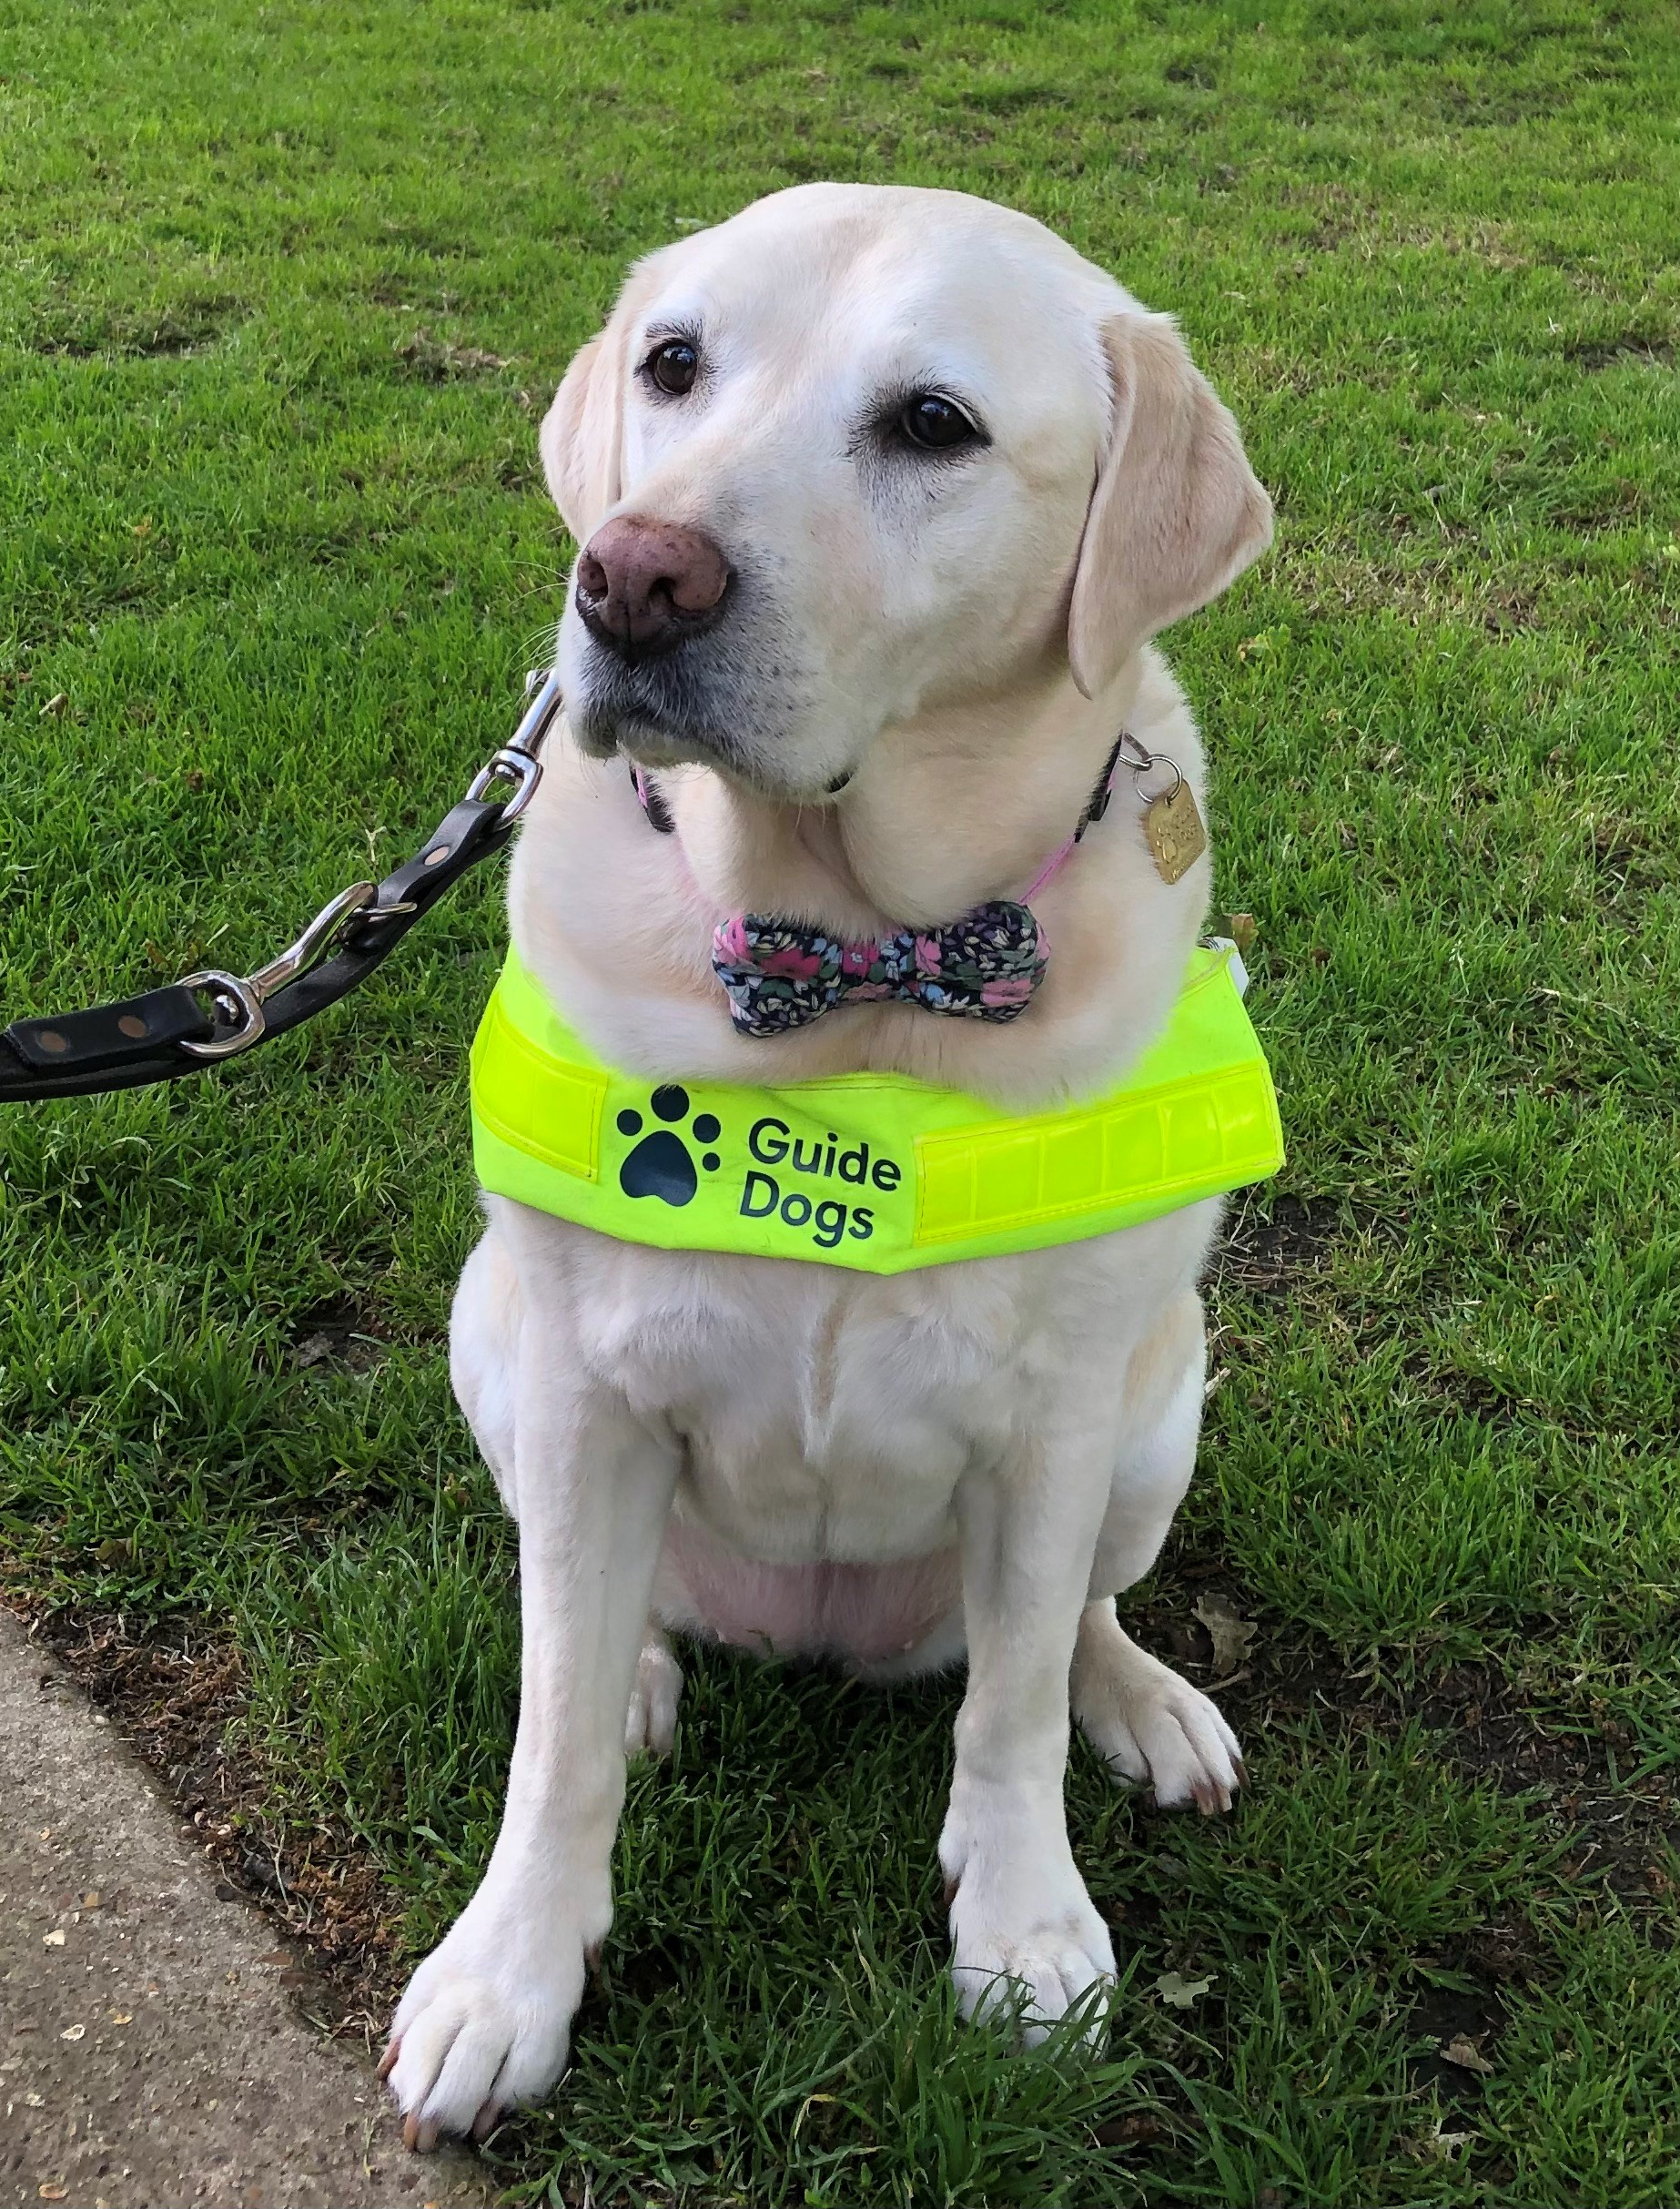
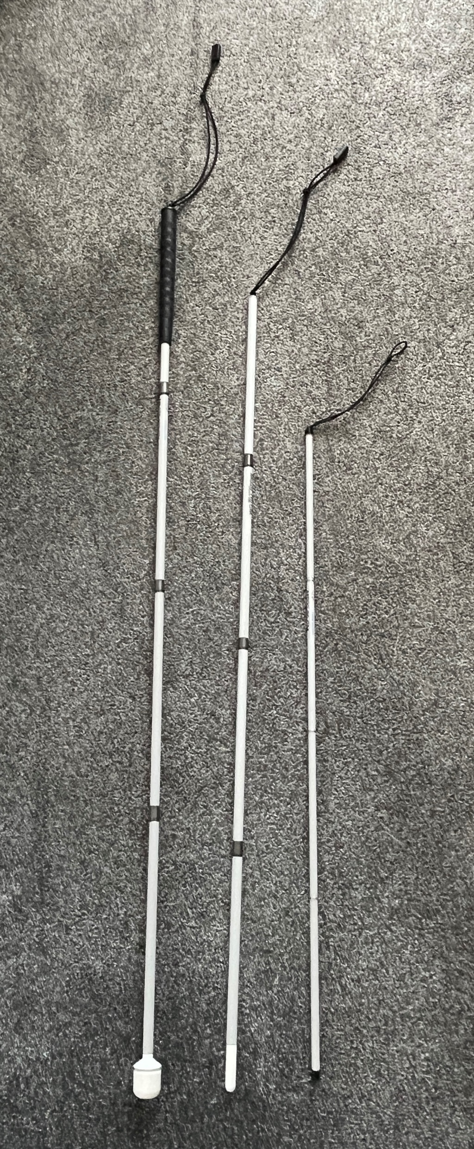
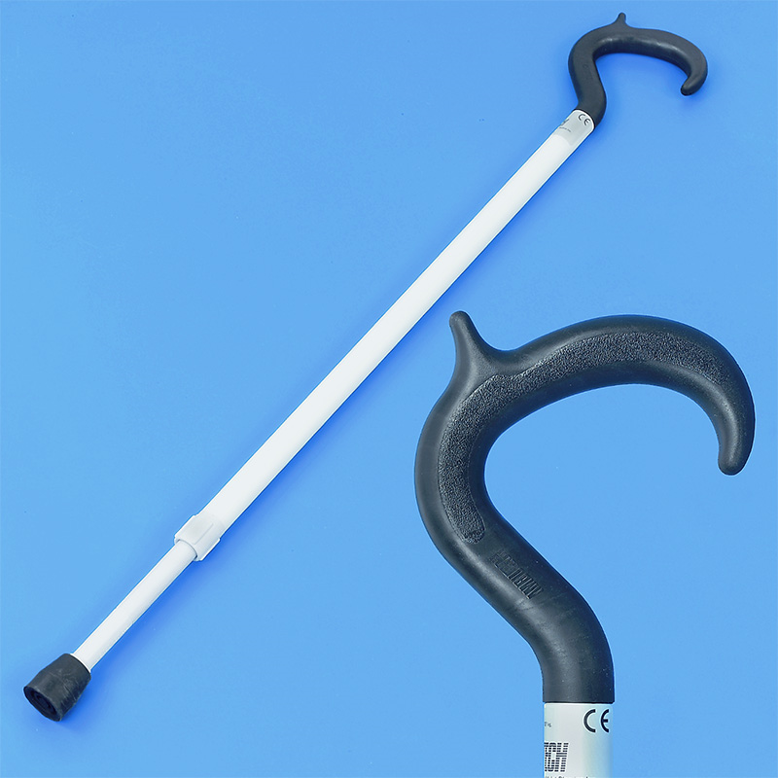
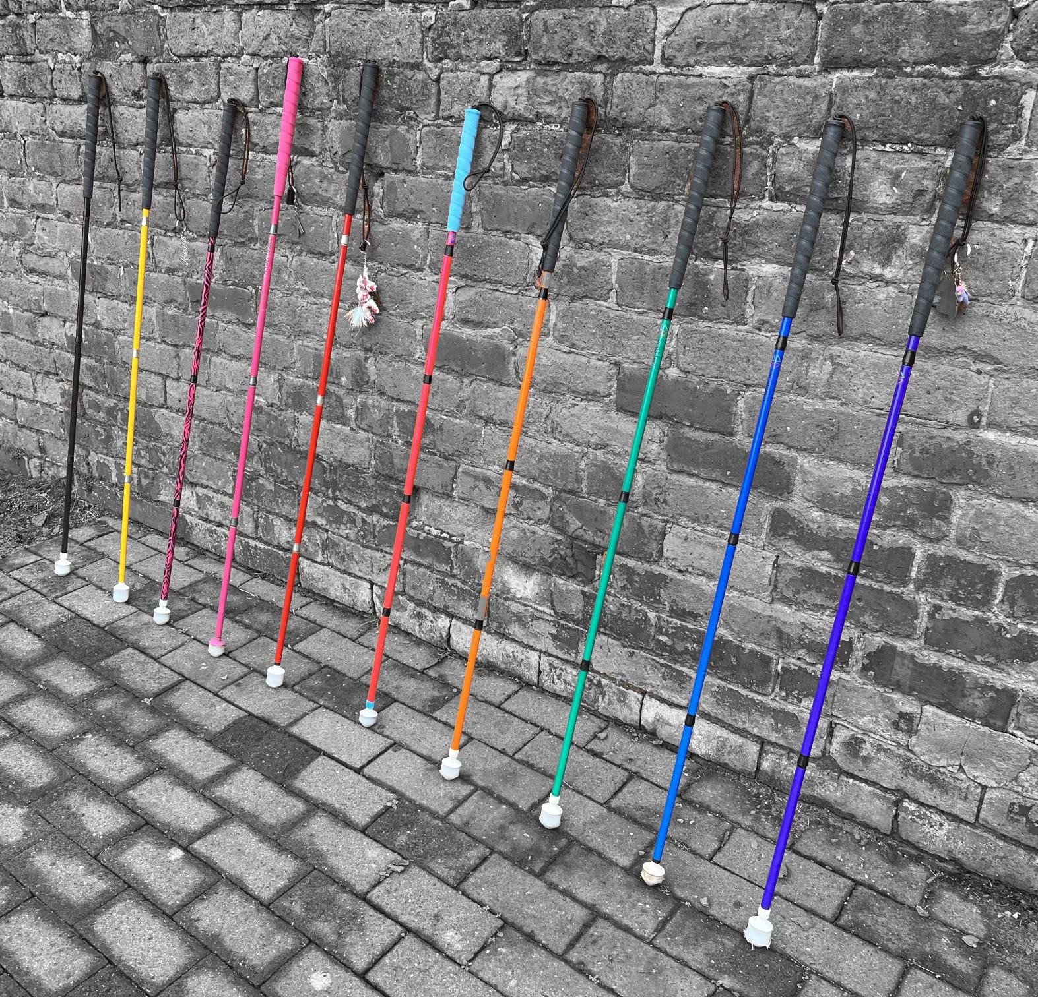
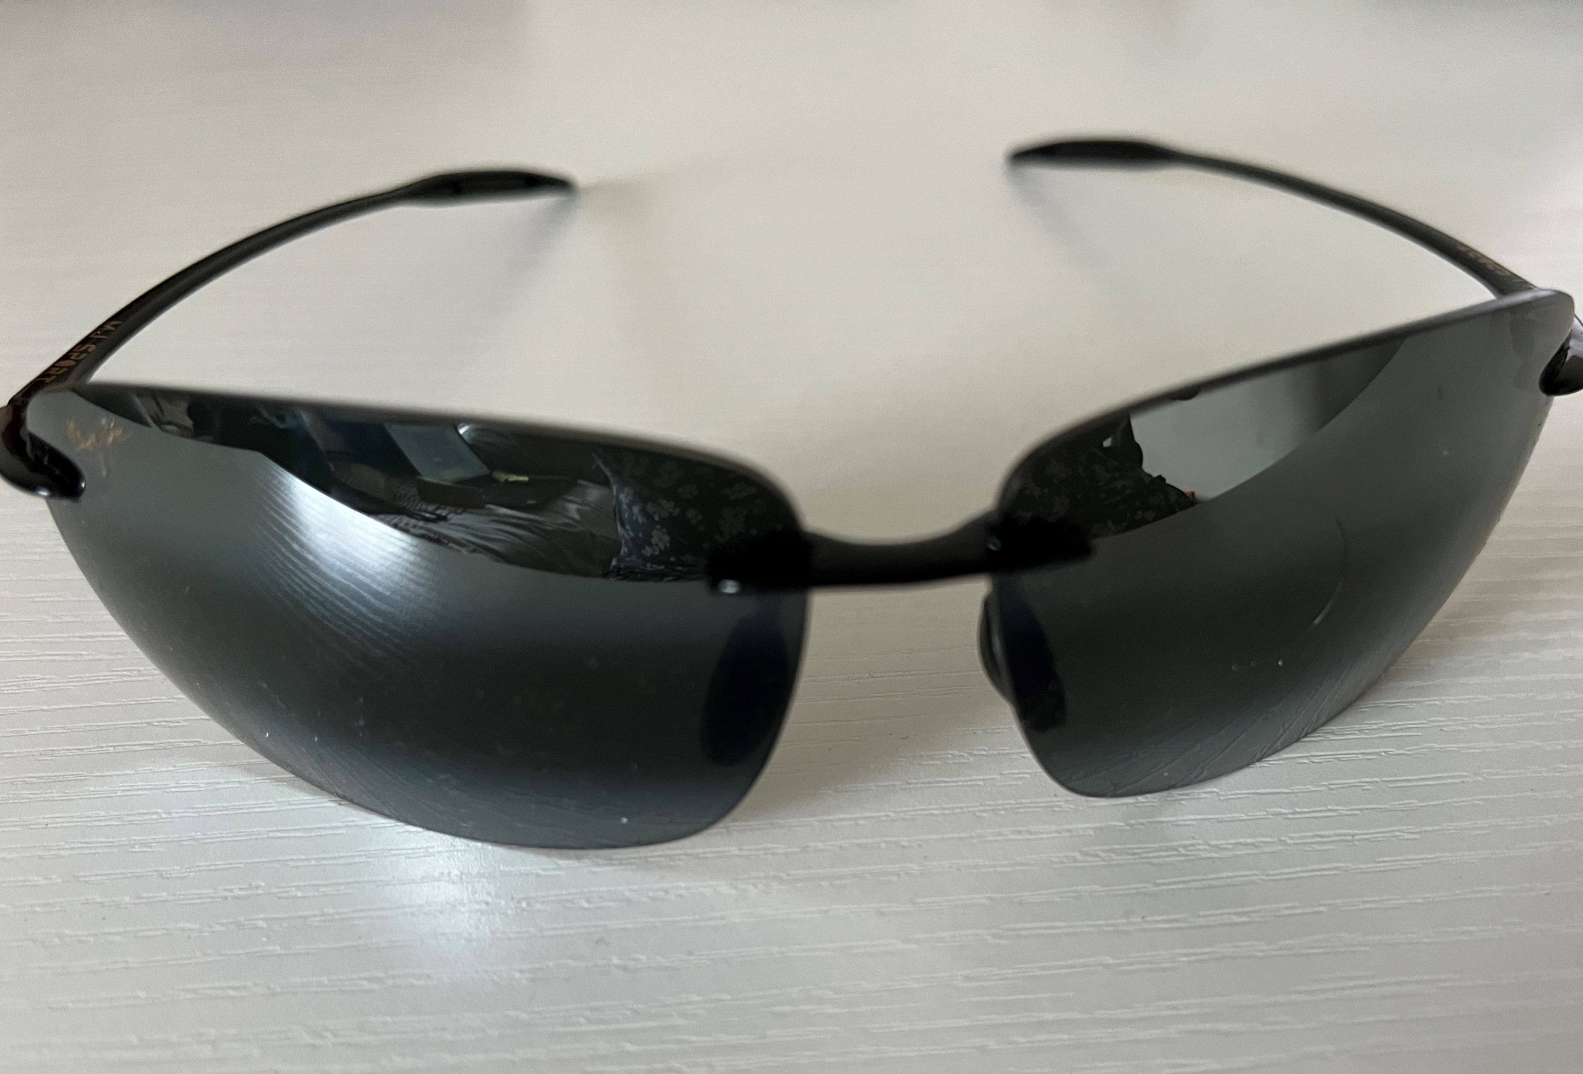
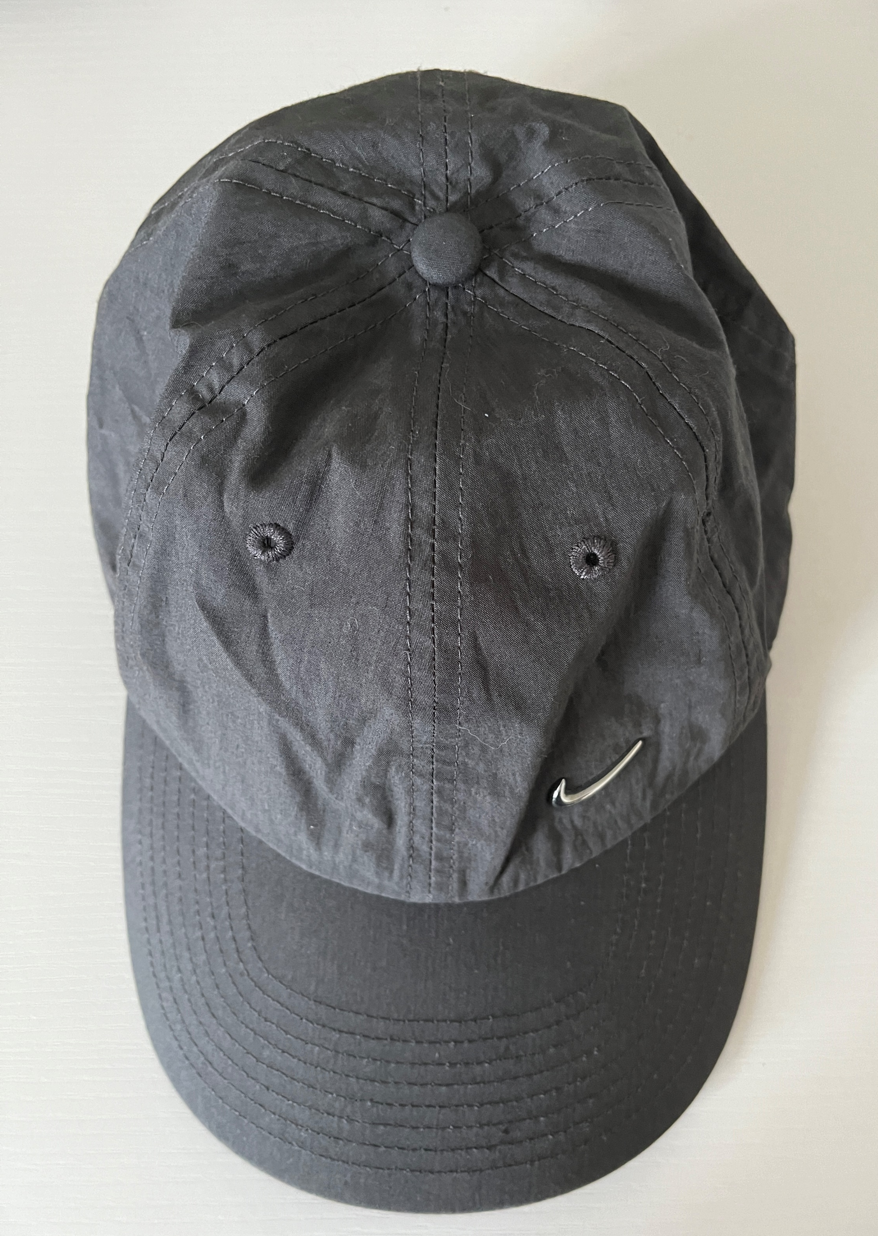
Recognising Blind and Partially Sighted People
How might you recognise someone who is blind or partially sighted?
There are lots of different types of mobility aids used by blind and partially sighted people.
Notes:
Facilitator answers:
Guide Dog
White cane (3 types: long, guide and symbol cane)
White walking stick (people may also use a white walking stick when they have a vision and mobility impairment)
Coloured canes
May wear a baseball cap or large brimmed hat
May wear sunglasses (some will have wrap around glasses, some people may prefer general sunglasses)
No eye contact (may not recognise this until you’re close to them)
Some people don’t use any mobility aids so you may not recognise that they have a vision impairment.

Slide 13
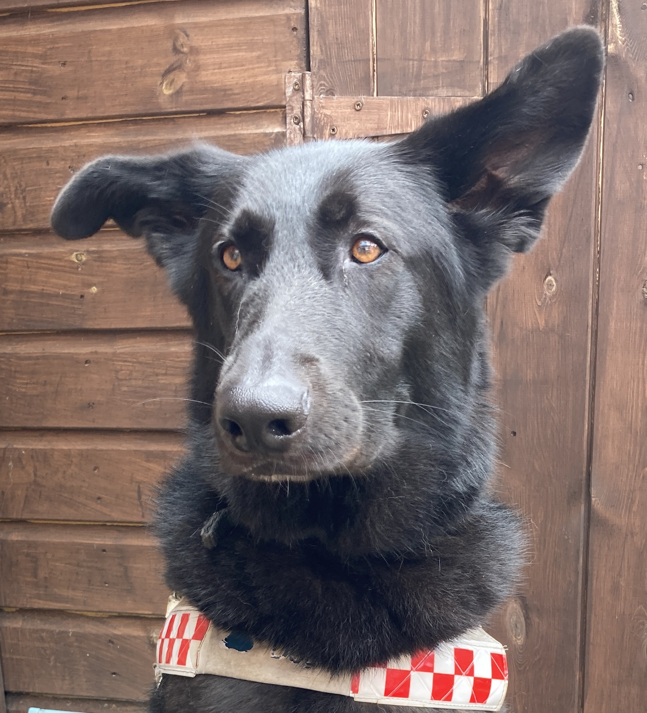

Dual Sensory Impairments
People with a dual sensory impairment would use the same mobility aids but these would have additional red markings. This indicates that the person has a sight and hearing impairment.

Slide 14
Dual Sensory Impairments
– Additional Support
Someone with dual sensory loss may require a bit more support. This might include:
Turning off the bus engine whilst they board (reduces background noise)
Speaking clearly and a little slower, but don't shout
Keeping your face visible
Making your lip patterns clear without over-exaggerating
Using gestures and facial expressions to support what you are saying.

Slide 15

Eyesight Conditions
Can you name any eyesight conditions?
There are hundreds of conditions and they all present in different ways. Some common conditions include:
Macular Degeneration
Glaucoma
Cataracts
Diabetic Retinopathy.
But you don’t need to worry about the condition….

Slide 16
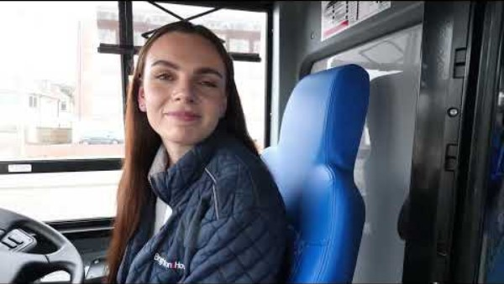
Clear Vision
Notes:
Narration:
This video shows what people can see if they don’t have a vision impairment. This includes people that wear glasses or contact lenses to correct their vision.
The following slides all show the same video of blind and partially sighted people boarding a bus, talking to the driver and taking a seat but have filters applied to simulate different eye conditions

Slide 17
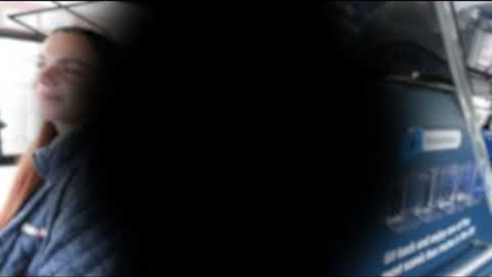
Central Vision Loss
Notes:
Narration:
Vision impairments that may cause central vision loss include:
Macular Degeneration
Stargardt’s Disease
Caused by:
A loss of the central field of vision due to damage or poor growth of the centre of the retina (the macula).
Impact:
Affects the vision you use when you’re looking directly at something, so could make spotting an approaching bus difficult, make it hard to read text such as a timetable and almost impossible to give any form of eye contact.

Slide 18
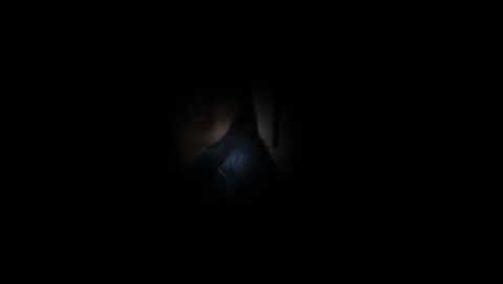
Peripheral Vision Loss
(Tunnel Vision)
Notes:
Narration:
Vision impairments that may cause peripheral vision loss include:
Glaucoma
Retinitis Pigmentosa
Caused by:
A loss of peripheral vision due to the outer part of the retina being damaged or deteriorating as a result of a medical condition, raised eye pressure or a weakness in the optic nerve.
Impact:
Can result in loss of depth perception, colour recognition and night vision. Makes orientation difficult, so affects going out, particularly to unfamiliar places. Due to the sudden change in light levels, navigating and finding a seat on a bus might be more challenging.

Slide 19
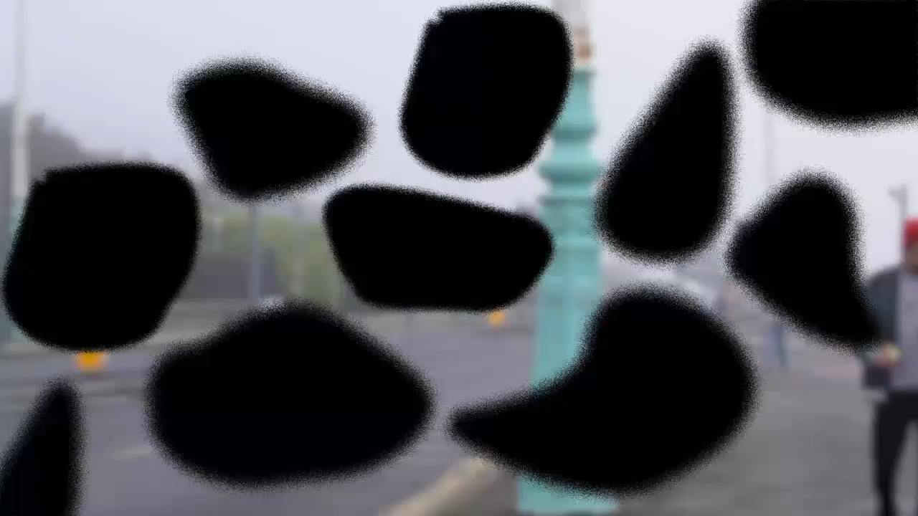
Patchy or Blurry Vision
Notes:
Narration:
The vision impairment that causes misty vision is:
Cataracts
Caused by:
A progressive thickening of the lens causing it to become less transparent (clear) and therefore clouding the vision.
Impact:
Affects clarity, can distort or cause double vision. Effects are greater in bright sunlight and at night. Makes any detailed work such as reading and writing difficult.

Slide 20
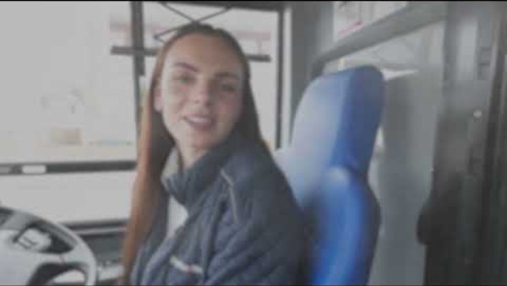
Misty Vision
Notes:
Narration:
The vision impairment that causes misty vision is:
Cataracts
Caused by:
A progressive thickening of the lens causing it to become less transparent (clear) and therefore clouding the vision.
Impact:
Affects clarity, can distort or cause double vision. Effects are greater in bright sunlight and at night. Makes any detailed work such as reading and writing difficult.

Slide 21

Light Perception Only
Notes:
Narration:
Many vision impairments may deteriorate over time leaving the person with light perception only. Some people may be born with no or little sight, known as congenital blindness.
Caused by:
A deteriorating vision impairment, undeveloped eyes or optic nerves, retinal detachment and trauma are all possible causes.
Impact:
Requires a mobility aid to navigate safely. Makes orientation difficult in unfamiliar places and surroundings. Makes it difficult to recognise people or objects. Would make recognising the bus, finding a ticket machine and finding an empty seat difficult.

Slide 22
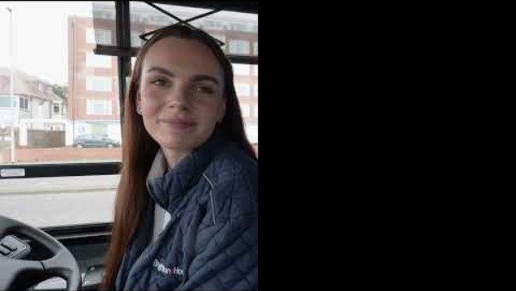
Brain Related
Vision Impairments
Notes:
Narration:
Many vision impairments may deteriorate over time leaving the person with light perception only. Some people may be born with no or little sight, known as congenital blindness.
Caused by:
A deteriorating vision impairment, undeveloped eyes or optic nerves, retinal detachment and trauma are all possible causes.
Impact:
Requires a mobility aid to navigate safely. Makes orientation difficult in unfamiliar places and surroundings. Makes it difficult to recognise people or objects. Would make recognising the bus, finding a ticket machine and finding an empty seat difficult.

Slide 23
Language
People are registered as either severely sight impaired (blind) or sight impaired (partially sighted).
Following a Thomas Pocklington Trust consultation, the preferred term identified was blind and partially sighted people.
Other terminology used includes sight loss, sight impaired, vision impaired and visually impaired.
How people choose to describe themselves in relation to their eye condition is individual and the term they use will depend on their personal preference.

Slide 24
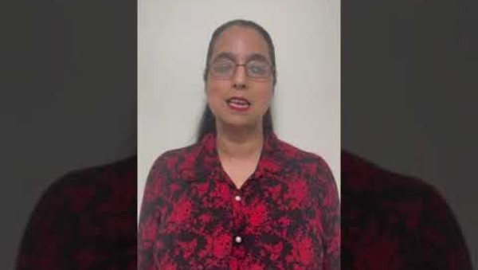
Communication
Amrit,
North London Sight Loss Council Volunteer

Slide 25
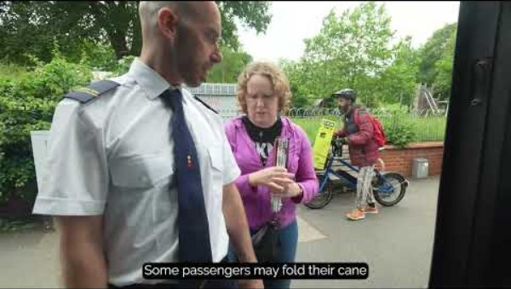
Sight guiding
There may be occasions where you need to guide a blind or partially sighted person, perhaps to support someone with crossing a road or with finding a seat on the bus.
There is a correct technique for guiding a blind or partially sighted person. The following video demonstrates this technique.

Slide 26
See and Stop
Why is it important to stop the bus if you see someone who is blind or partially sighted waiting at the bus stop?
Blind and partially sighted people are unlikely to see a bus approaching which makes it difficult, sometimes impossible, to know when to put their hand out to indicate that they want the bus to stop.
Stopping the bus without someone needing to wave or put their hand out means that blind and partially sighted people are more relaxed when waiting for a bus. When you can’t see or have little vision, it can be very stressful not knowing whether the bus will stop. Just like other people, missing a bus could mean that they’re late for work, an appointment or prevent them from getting on with their day. In some cases, there might not be another bus for an hour or longer, so it could really spoil their day.

Slide 27
Speak and Support
Why is it important to speak clearly and support a blind or partially sighted passenger?
Blind and partially sighted people usually rely more heavily on audible cues and descriptions. Buses can be busy and noisy which often makes it harder to hear. Some passengers may also have a hearing impairment so speaking clearly is essential to ensure they understand you.
Taking the bus when you have a vision impairment is much harder and can be frightening, disorientating and stressful. Many blind and partially sighted people feel anxious about travelling and the challenges they could face on a journey. Offering the right support can make a huge difference and allow a blind or partially sighted person to feel safe, confident and travel independently.

Slide 28
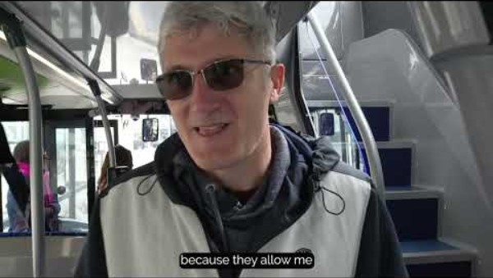
Helping Blind and Partially Sighted Passengers

Slide 29
Information
Sources of further information:
Thomas Pocklington Trust: www.pocklington.org.uk/
Sight Loss Councils: www.sightlosscouncils.org.uk/
Sight Loss Councils, funded by Thomas Pocklington Trust, are regional groups led by blind and partially sighted people. Together, they work with organisations to ensure what they do is accessible and inclusive.
Thomas Pocklington Trust is a national sight loss charity. We offer support across our key priority areas: education, employment, health, and inclusive communities. Our work is deeply rooted in the blind and partially sighted community, prioritising their voices and lived experiences, fostering authenticity, and positioning us as leaders of positive change.

Slide 30
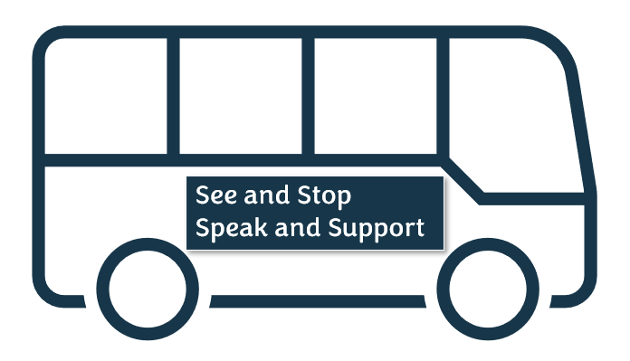
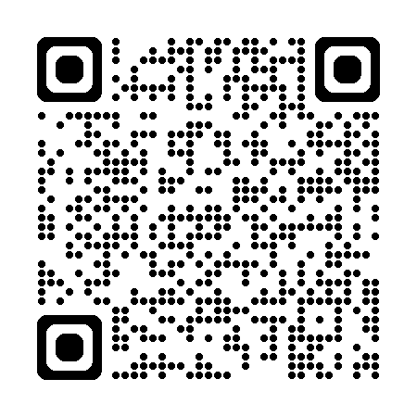
See and Stop, Speak and Support
Thank you for participating, please take the time to complete our evaluation form on the QR code above

